Slide 1
Code and Data for the Social Sciences: A Practitioner’s Guide
(Gentzkow and Shapiro 2014)
George Knox

Slide 2
Agenda
Intro
Automation
Version Control
Directories
Keys
Abstraction
Documentation
Management
GitHub exercise

Slide 3
Introduction
As a masters/PhD student, two of the most important skills for my career which I didn’t appreciate at the time:
Writing
Coding (our focus today)
Most learning here self-taught, just-in-time (what GS call “seat-of-the-pants”) to solve a particular problem
Limits to this approach as data sets get messier, more collaborators, replication policies at journals.

Slide 4
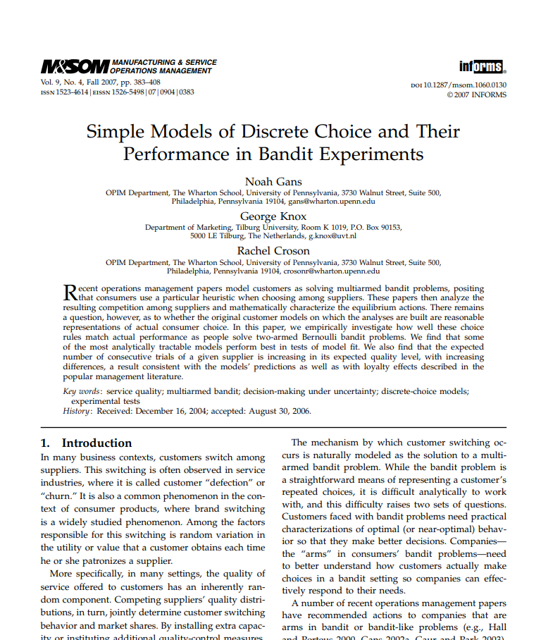
Problems
In my first project, we collected sequential choice data from bandit experiments.
Scholar: 75 citations
Fit various models to this data to see which model fits data best
All data & analysis done in Excel, often same spreadsheet (!)

Slide 5
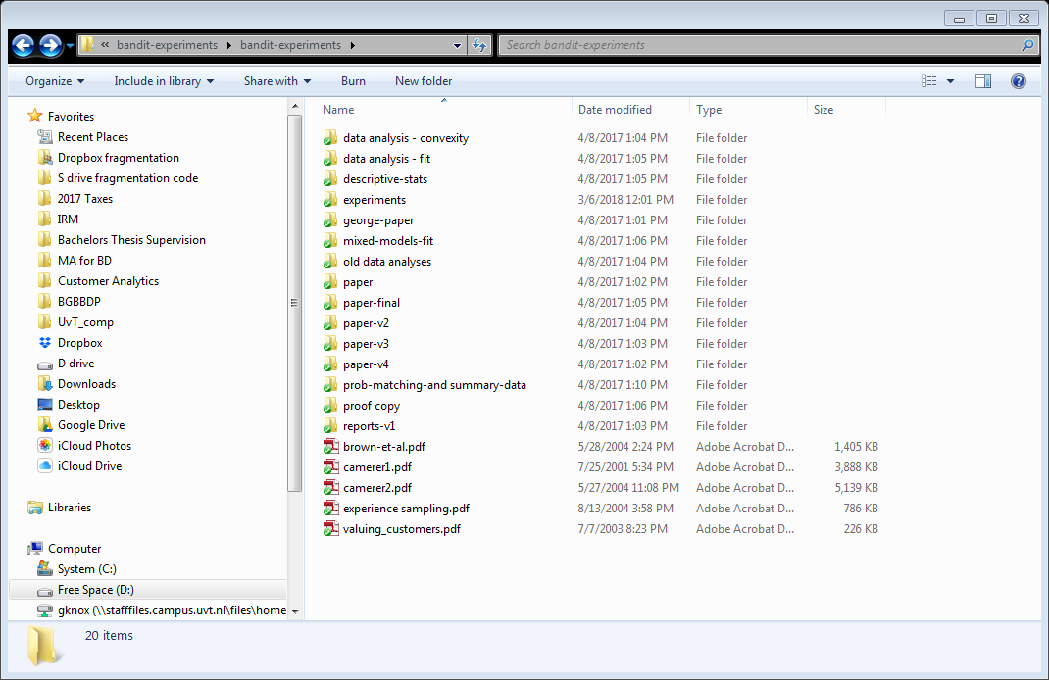
Folder: a mess
What is George-paper,
And how is it different from paper …?

Slide 6
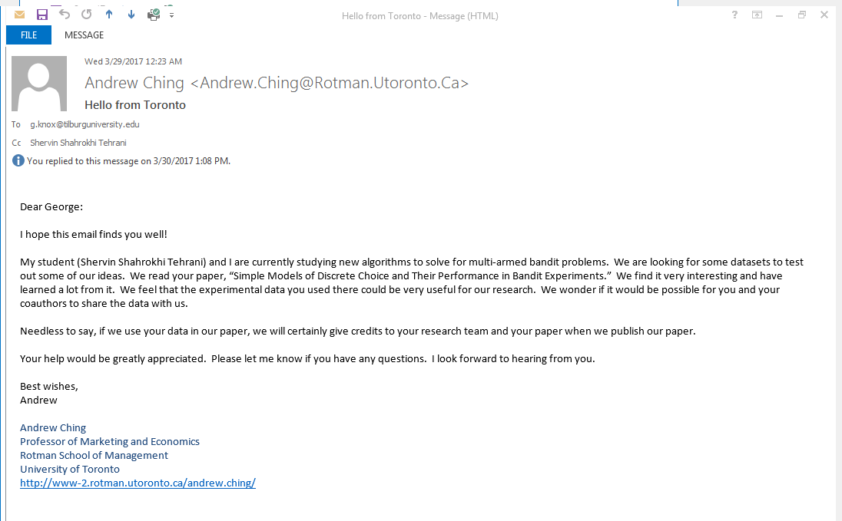

Slide 7
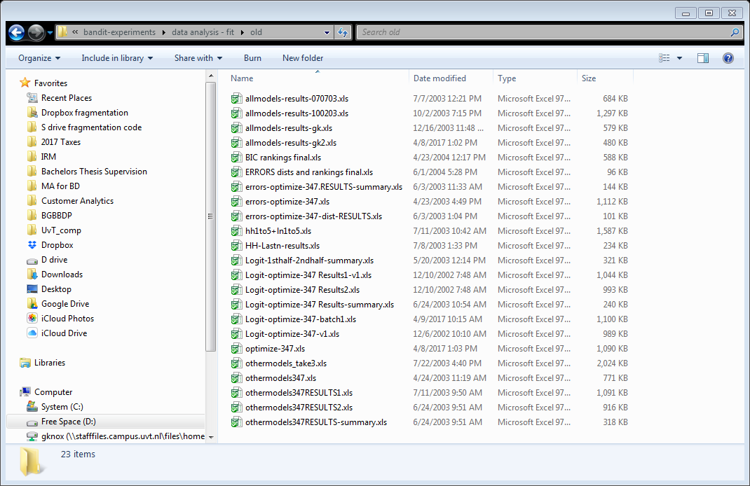
Where’s the original data?

Slide 8
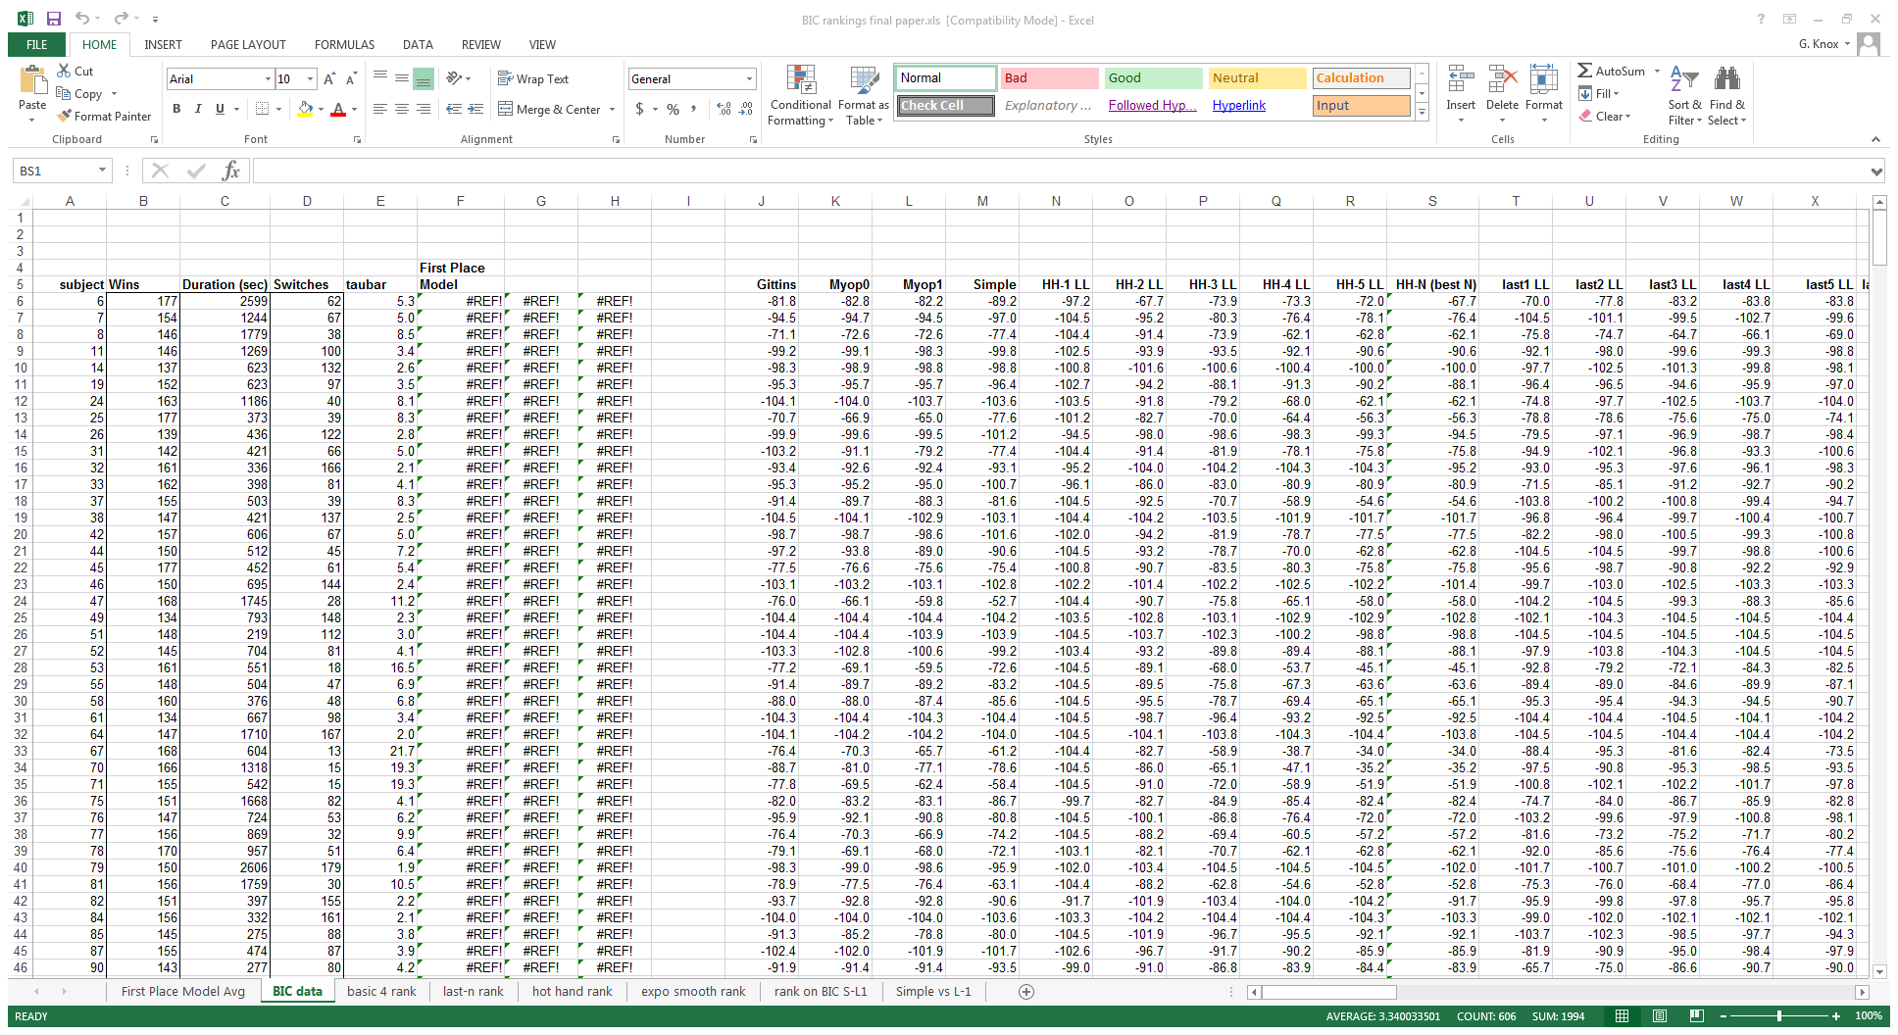
Example of file:

Slide 9
2. Automation
Why is this interactive mode bad? What does it lack?
Replicability: we can reproduce the results whenever we want to
Efficiency: making changes to the data, we have to start from the beginning, repeating all the steps.
Consider the fact that you will change your code hundreds/thousands/millions of times before paper is accepted.
Small increases in efficiency will pay off soon

Slide 10
Automation: better directory
Say we want to estimate the effect of introduction of TV on potato chip consumption
chips.csv | mergefiles.do | tv_potato_submission.pdf
cleandata.do | regressions_alt.do | tv_potato.tex
extract0B.xls | regressions_alt.log | tv.csv
fig1.eps | regressions.do | tvdata.dta
fig2.eps | regressions.log
figures.do | tables.txt

Slide 11
Automation: better
extract0B = raw data
chips.csv and tv.csv exported
mergefiles.do and cleandata.do build data
tvdata.dta is the merged stata file
figures, regressions output the figures and tables
.tex file for the submission
chips.csv | mergefiles.do | tv_potato_submission.pdf
cleandata.do | regressions_alt.do | tv_potato.tex
extract0B.xls | regressions_alt.log | tv.csv
fig1.eps | regressions.do | tvdata.dta
fig2.eps | regressions.log
figures.do | tables.txt
But what order do we run these to replicate submission file?
e.g., clean or merge first?

Slide 12
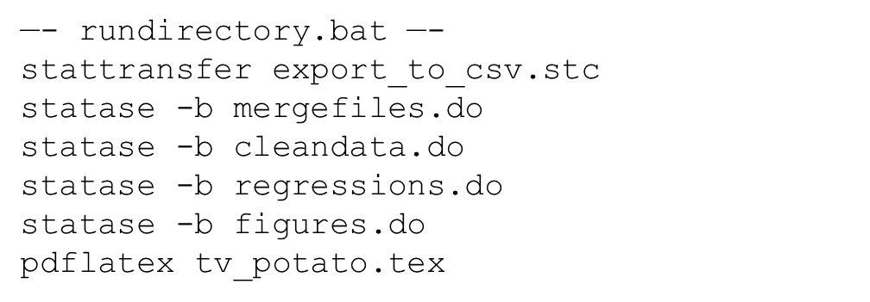
Fully automated approach
All steps controlled by a shell script
Order clear
Easy to call commands from different packages

Slide 13
Here’s the make.bat we’ll run later
@echo off
set statapath="c:\Program Files (x86)\Stata14\StataSE-64.exe"
echo %statapath%
REM DELETE OUTPUT & TEMP FILES
RMDIR ..\output /S /Q
mkdir ..\output
RMDIR ..\temp /S /Q
mkdir ..\temp
REM IMPORT
%statapath% /e do import.do
REM PRE-CLEAN
%statapath% /e do preclean.do
REM RUN ANALYSIS
%statapath% /e do regression.do
pause
Clear out output and temp directories.. WHY?
Execute import, then preclean, then regression

Slide 14
Automation Summary
Automate everything that can be automated
Write a single script that executes all code from beginning to end

Slide 15
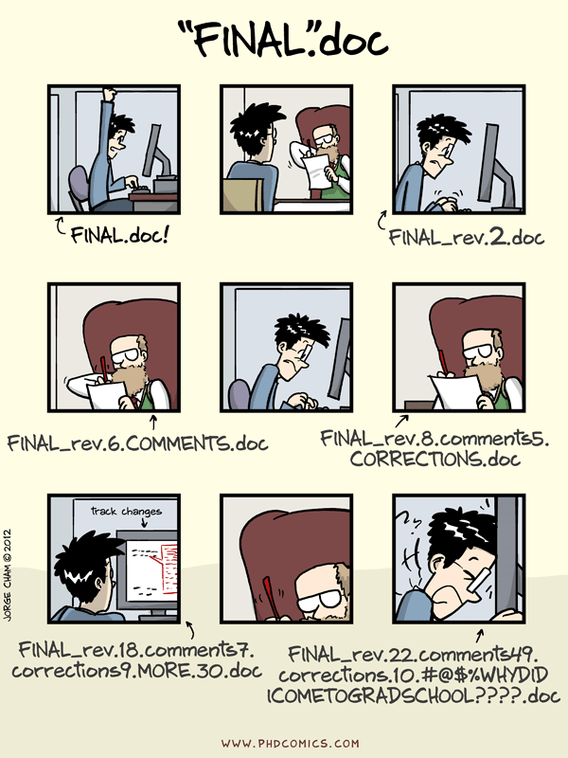

Slide 16
3. Version control: the old way
cleandata_022113.do | cleandata_022613.do | regressions.log
cleandata_022113a.do | cleandata_022613_jms.do | regressions_022413.do
chips.csv | tvdata.dta | regressions_022713_mg.do
regressions_022413.log
Dates used note versions, initials authors
Why do this?
Facilitates comparison
Facilitates undo-ing, rolling back changes

Slide 17
3. Version control: the old way
cleandata_022113.do | cleandata_022613.do | regressions.log
cleandata_022113a.do | cleandata_022613_jms.do | regressions_022413.do
chips.csv | tvdata.dta | regressions_022713_mg.do
regressions_022413.log
Why not do this:
Pain: always have to remember to tag every new file
Confusing:
Which log file came from regressions_022713_mg.do?
Which version of cleandata.do makes the data used by regressions_022413.do?
No software firm does this.

Slide 18
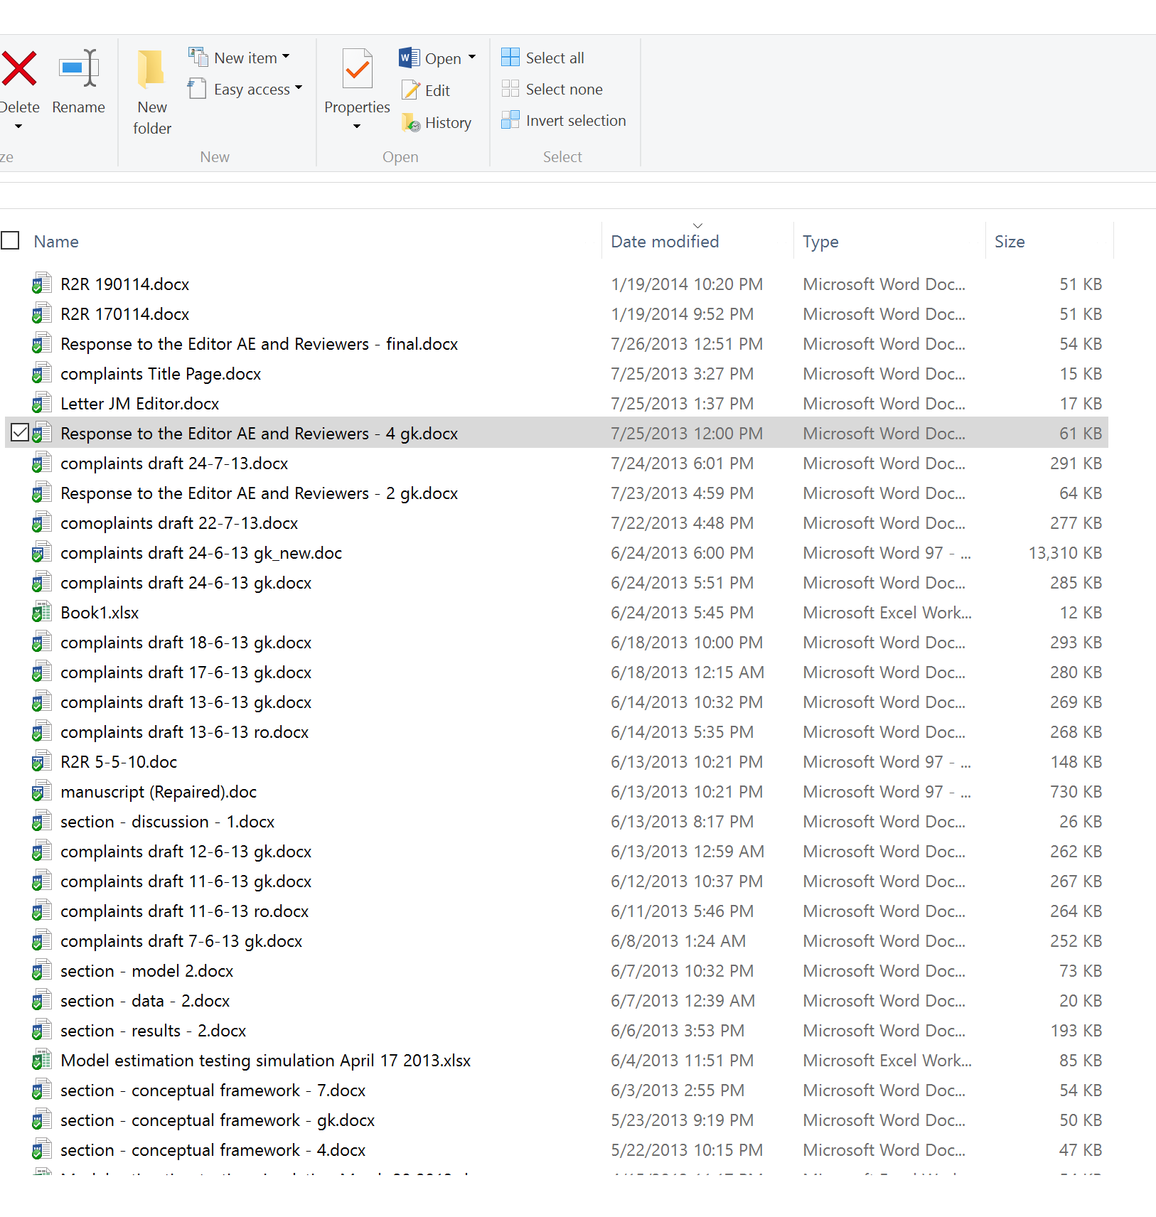
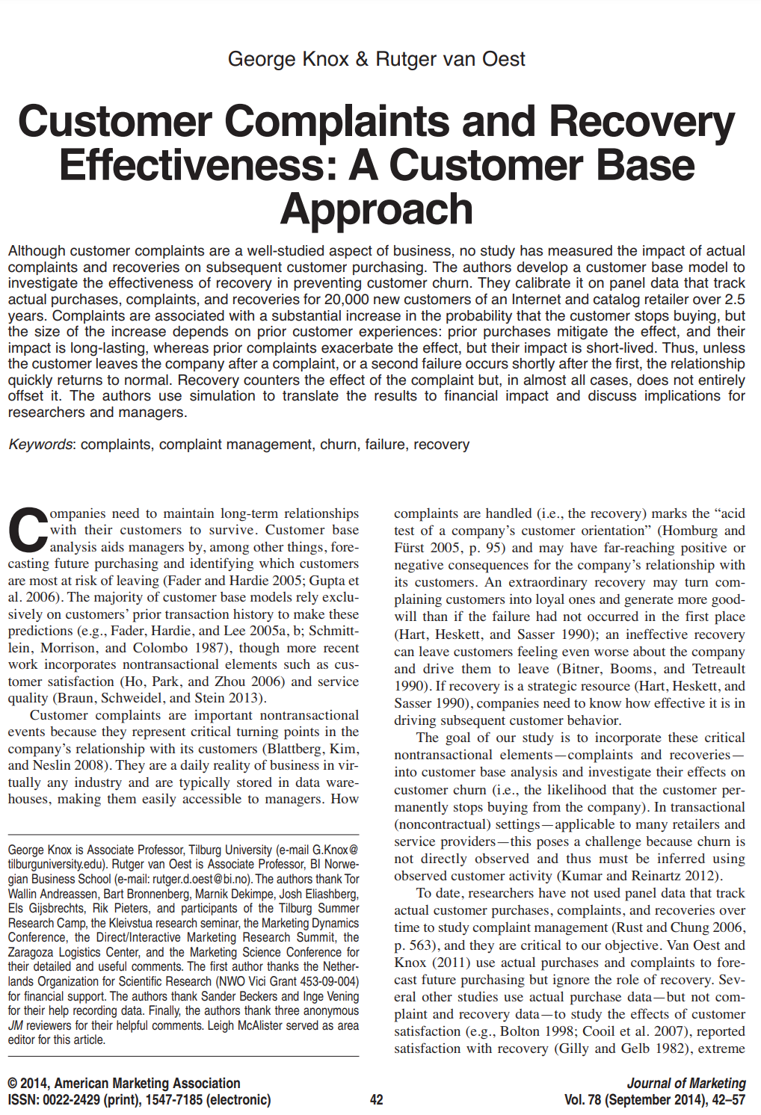

Slide 19
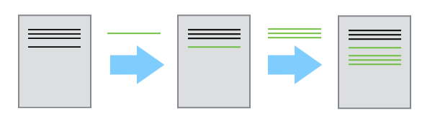
Version control: the new way
Unlimited “undo” – can roll back as much as you want
Adding changes rather than
saving the complete files

Slide 20
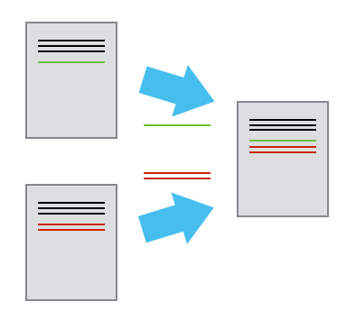
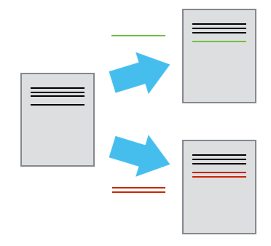
Version control: the new way
Work in parallel
Two users make
independent changes
changes are merged
Conflicts are tagged and resolved

Slide 21
Version control: directory
rundirectory.bat | tvdata.dta
cleandata.do | regressions.do
chips.csv | regressions.log
Single authoritative version of the directory
Edit without fear: an undo command for everything
Punchline:
Store code and data under version control

Slide 22
Version control: problem
Problem arises if someone edits cleandata.do, generating a new tvdata.dta
Regressions.do doesn’t work because tvdata.dta has changed
rundirectory.bat | tvdata.dta
cleandata.do | regressions.do
chips.csv | regressions.log

Slide 23
Version control: solution
Make sure to run the entire directory before checking in changes
Run “rundirectory.bat”
rundirectory.bat | tvdata.dta
cleandata.do | regressions.do
chips.csv | regressions.log

Slide 24
Version control
There are many systems
Git is most popular today (that’s why I use it)
Main difference with legacy systems
legacy systems require a server – Git stores history locally
git uses “remotes” [optional] – online sharing/collaboration
active “open source” community of Git
I combine Git with other things
Git: version control for text/code files
[Git LFS (large file system): version control for large files] (e.g., pictures)
Amazon’s AWS S3 for huge files (>1GB)

Slide 25
4. Directories
——C:/tv_and_potato/——
chips.csv | mergefiles.do | tv_potato_submission.pdf
cleandata.do | regressions_alt.do | tv_potato.tex
extract0B.xls | regressions_alt.log | tv.csv
fig1.eps | regressions.do | tvdata.dta
fig2.eps | regressions.log | rundirectory.bat
figures.do | tables.txt | export_to_csv.stc
Problem:
The researcher wants to change a regression specification, but does not want to re-run the entire data build.

Slide 26
Modular structure
——C:/build—— | ——C:/analysis——
/input | /input
extract0B.xls | tvdata.dta (link to C:/build/output)
/code | /code
rundirectory.bat | rundirectory.bat
export_to_csv.stc | regressions.do
mergefiles.do | regressions_alt.do
/output | /output
tvdata.dta | fig1.eps
 | fig2.eps
 | tables.txt
/temp | /temp
chips.csv | regressions.log
tv.csv | regressions_alt.log
Local references
../input/tvdata.dta
Multiple projects:
Same data
Build a useable Stata file from raw inputs
Take Stata dta file and create tables and figures

Slide 27
Our repo structure for Spotify paper
1.4) REPOSITORY STRUCTURE
\root\spotify\raw Code required to collect/download raw data
\root\spotify\derived Data preparation
\root\spotify\pre-analysis Analysis Part 1: Creating metrics
\root\spotify\analysis Analysis Part 2: Matching and Diff-in-diff
\root\spotify\draft Stores literature reference
\root\spotify\slides_beamer Slides
\root\spotify\tools Tools/programs/templates
Each directory contains a makefile in a subdirectory \code.

Slide 28
Keys
county | state | cnty_pop | state_pop | region
36037 | NY | 3817735 | 43320903 | 1
36038 | NY | 422999 | 43320903 | 1
36039 | NY | 324920 | . | 1
36040 | . | 143432 | 43320903 | 1
. | NY | . | 43320903 | 1
37001 | VA | 3228290 | 7173000 | 3
37002 | VA | 449499 | 7173000 | 3
37003 | VA | 383888 | 7173000 | 4
37004 | VA | 483829 | 7173000 | 3

Slide 29
Keys
county | state | cnty_pop | state_pop | region
36037 | NY | 3817735 | 43320903 | 1
36038 | NY | 422999 | 43320903 | 1
36039 | NY | 324920 | . | 1
36040 | . | 143432 | 43320903 | 1
. | NY | . | 43320903 | 1
37001 | VA | 3228290 | 7173000 | 3
37002 | VA | 449499 | 7173000 | 3
37003 | VA | 383888 | 7173000 | 4
37004 | VA | 483829 | 7173000 | 3

Slide 30
Relational database
variables
county | state | population
36037 | NY | 3817735
36038 | NY | 422999
36039 | NY | 324920
36040 | NY | 143432
37001 | VA | 3228290
37002 | VA | 449499
37003 | VA | 383888
37004 | VA | 483829
state | population | region
NY | 43320903 | 1
VA | 7173000 | 3
elements
Data stored in “normalized” format
A key is variable or set that uniquely identifies elements of a table
Tables are connected by foreign keys (state)

Slide 31
Steps
To run the analysis, you need to merge the data
Do this last
Store data in normalized format
Construct second set of files with key transformations (log population)
Merge data together and run the analysis

Slide 32
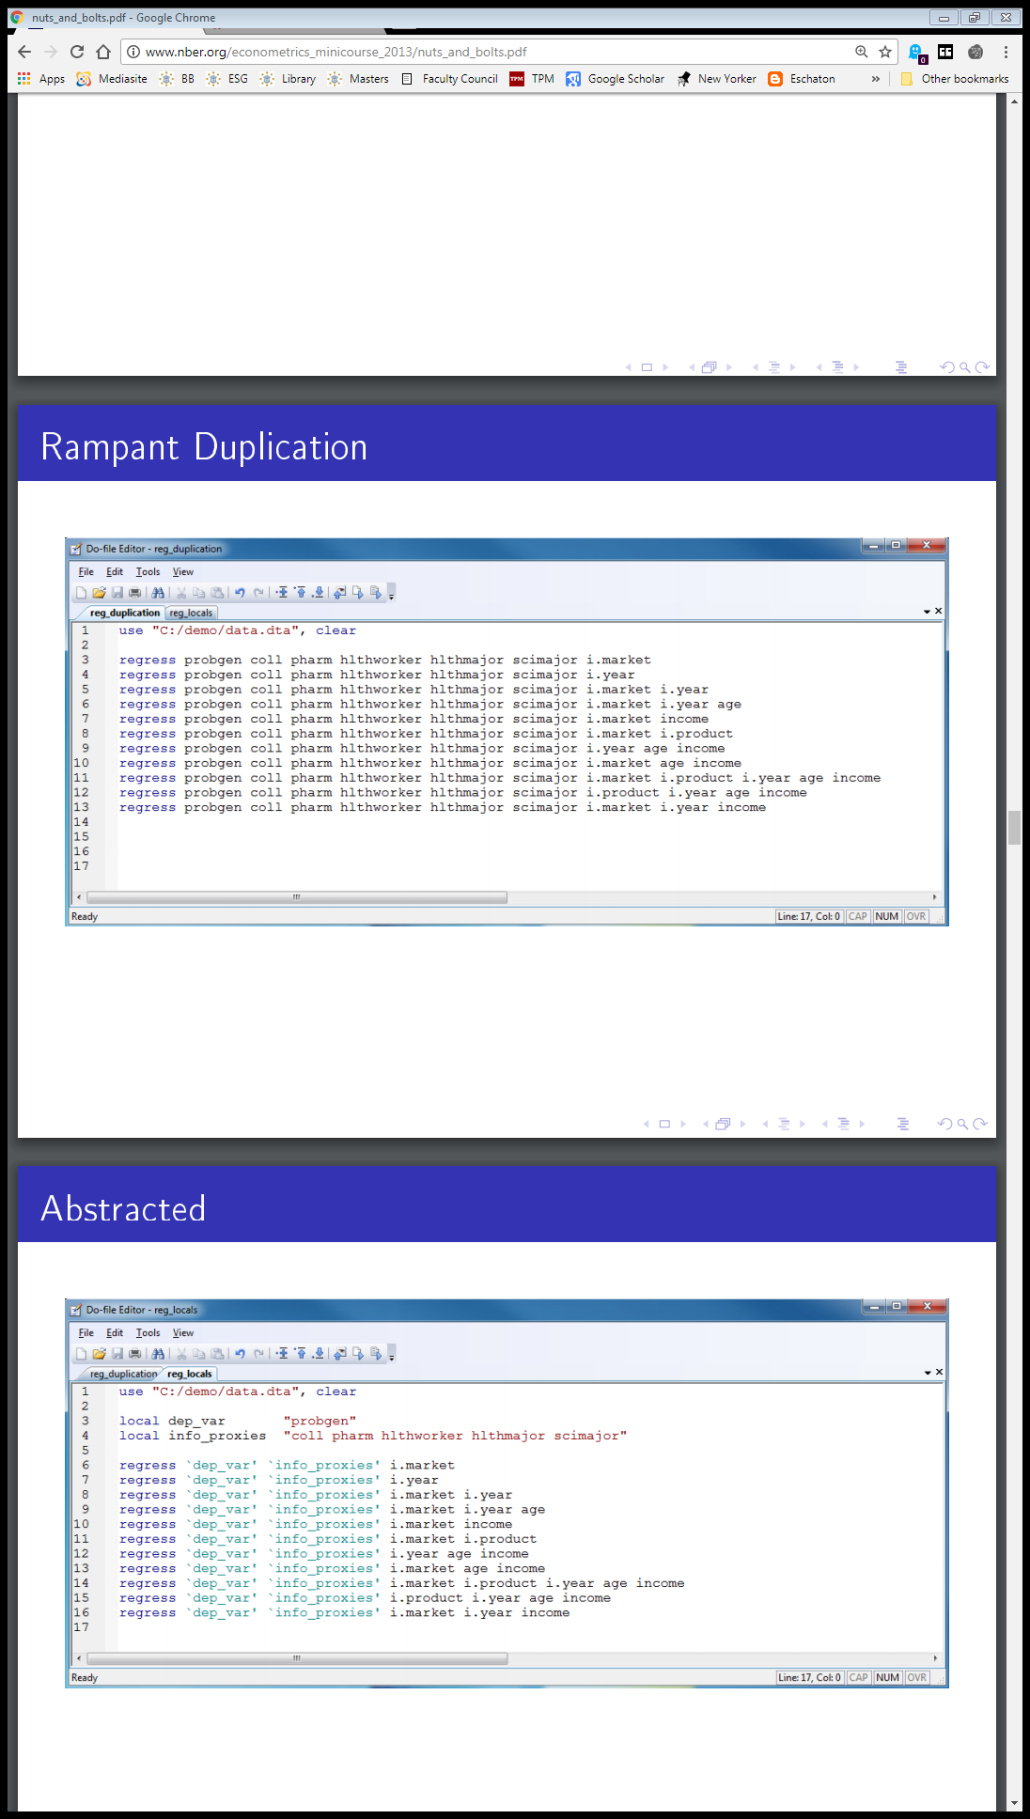
Abstraction

Slide 33
Copy paste errors
Leave-out of per capita (pc_potato)
at county level
egen total_pc_potato = total(pc_potato), by(state)
egen total_obs = count(pc_potato), by(state)
gen leaveout_state_pc_potato = (total_pc_potato - pc_potato) / (total_obs - 1)
at metro area
egen total_pc_potato = total(pc_potato), by(metroarea)
egen total_obs = count(pc_potato), by(state)
gen leaveout_metro_pc_potato = (total_pc_potato - pc_potato) / (total_obs - 1)
at household (rather than capita) level at metro area
egen total_hh_potato = total(hh_potato), by(metroarea)
egen total_obs = count(hh_potato), by(state)
gen leaveout_metro_hh_potato = (total_hh_potato - pc_potato) / (total_obs - 1)

Slide 34
Better way
program leaveout_mean
syntax, invar(varname) outvar(name) byvar(varname)
tempvar tot_invar count_invar
egen `tot_invar'= total(`invar'), by(`byvar')
egen `count_invar'= count(`invar'), by(`byvar')
gen `outvar' = (`tot_invar' - `invar') / (`count_invar' - 1)
end
leaveout_mean, invar(pc_potato) outvar(leaveout_state_pc_potato) byvar(state)
leaveout_mean, invar(pc_potato) outvar(leaveout_metro_pc_potato) byvar(metro)
leaveout_mean, invar(hh_potato) outvar(leaveout_metro_hh_potato) byvar(metro)

Slide 35
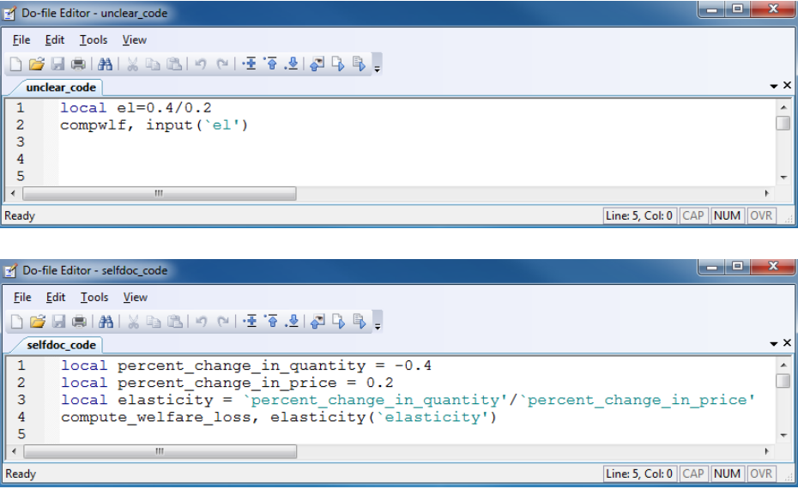
Documentation
Don’t write documentation you will not maintain
Code should be self-documenting

Slide 36
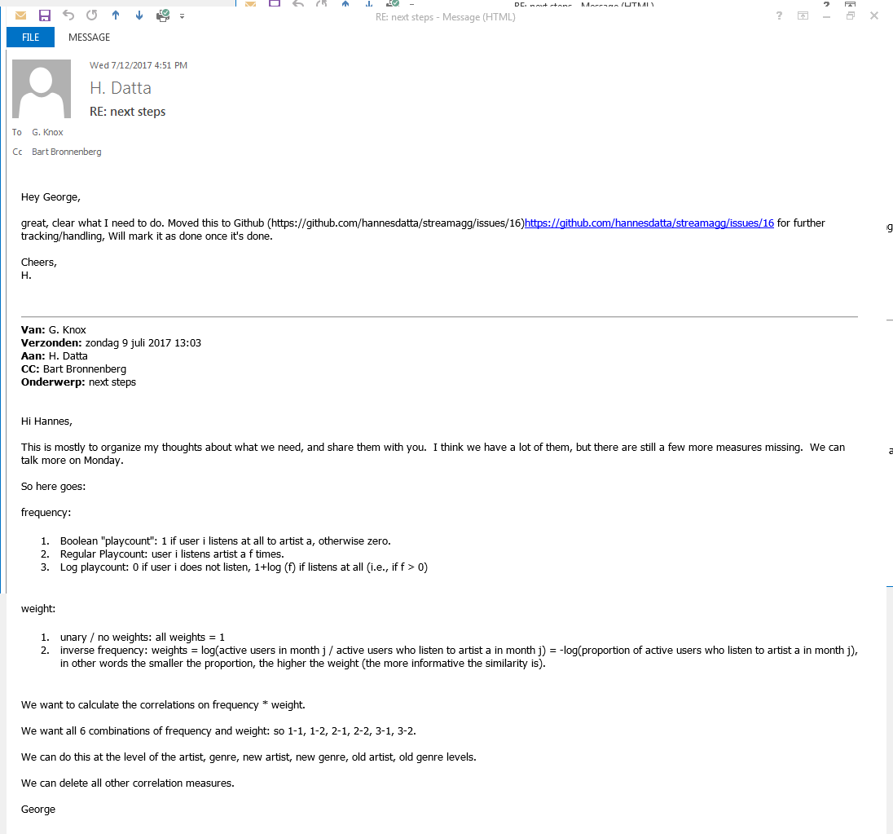
Management
Email is not the way to manage tasks
Who is responsible?
When is it done?

Slide 37
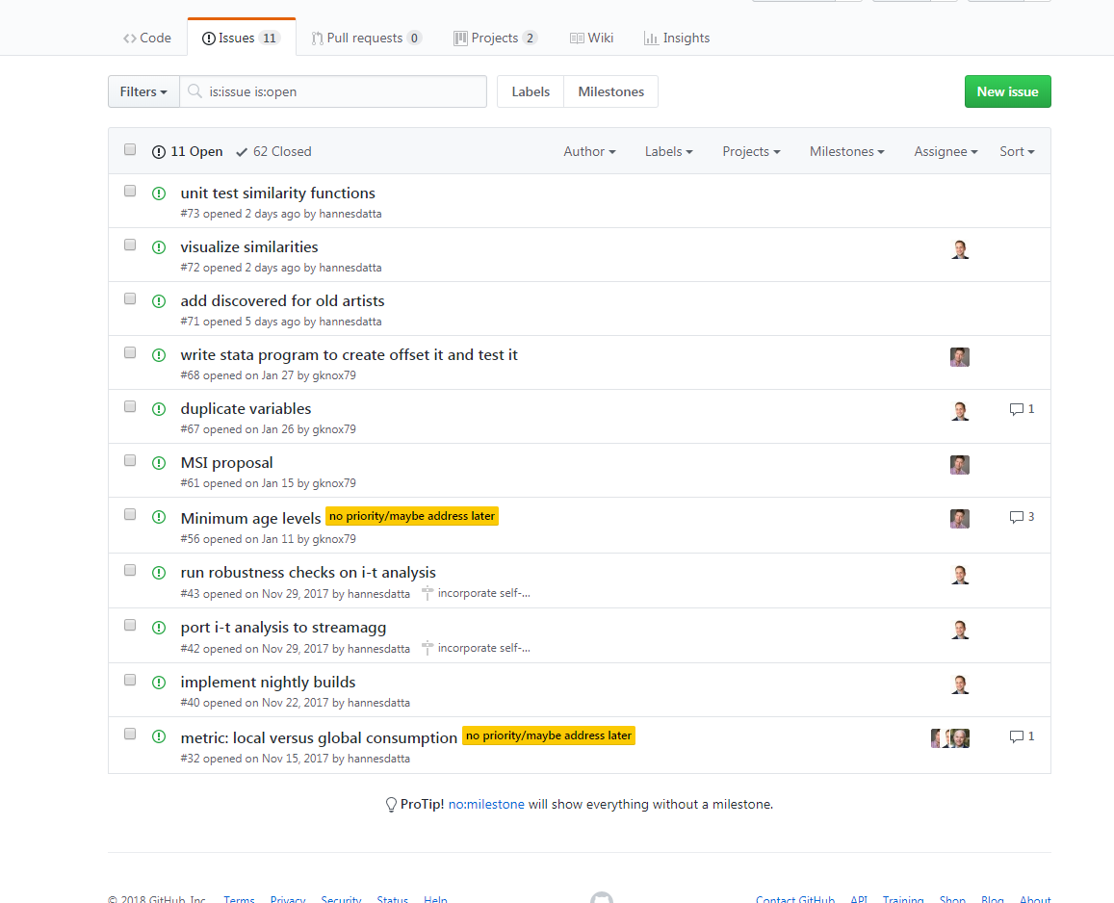

Slide 38
In-class assignment
We’re all working on a research project together, predicting prices of cars given some features about the car {mpg, length, turning radius etc.}
You can work in pairs if that makes it easier.

Slide 39
Fork a repo
A fork is a copy of a repository. Forking a repository allows you to freely experiment with changes without affecting the original project.
from https://help.github.com/articles/fork-a-repo/

Slide 40
Fork a repo
Propose changes to someone else's project
A great example of using forks to propose changes is for bug fixes. Rather than logging an issue for a bug you've found, you can:
Fork the repository.
Make the fix.
Submit a pull request to the project owner.
Use someone else's project as a starting point for your own idea.
At the heart of open source is the idea that by sharing code, we can make better, more reliable software.
When creating your public repository from a fork of someone's project, make sure to include a license file that determines how you want your project to be shared with others.

Slide 41
Instructions
On GitHub, navigate to the gknox79/code_data repository.
In the top-right corner of the page, click Fork

Slide 42
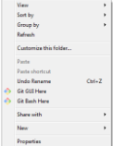
Set up Git
(Install Git: https://git-scm.com/downloads)
In some place where you want to save files locally, right click & select Git Bash Here

Slide 43
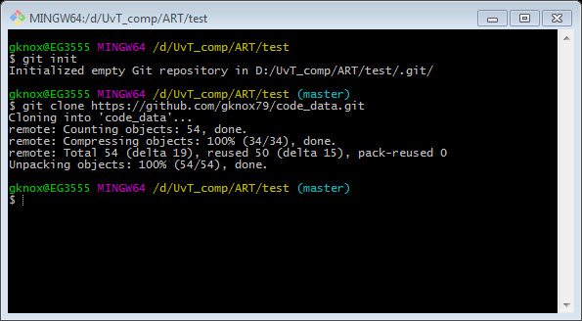
Create a local clone of your fork
git init
git clone https://github.com/gknox79/code_data.git

Slide 44
Inspect the code
run make.bat: does it work? do you see log files, output, etc.?
Key line of code you’ll probably have to adjust:
open make.bat in notepad or something similar
Wherever stata resides on your machine:
"C:\Program Files (x86)\Stata14\StataSE-64.exe"

Slide 45
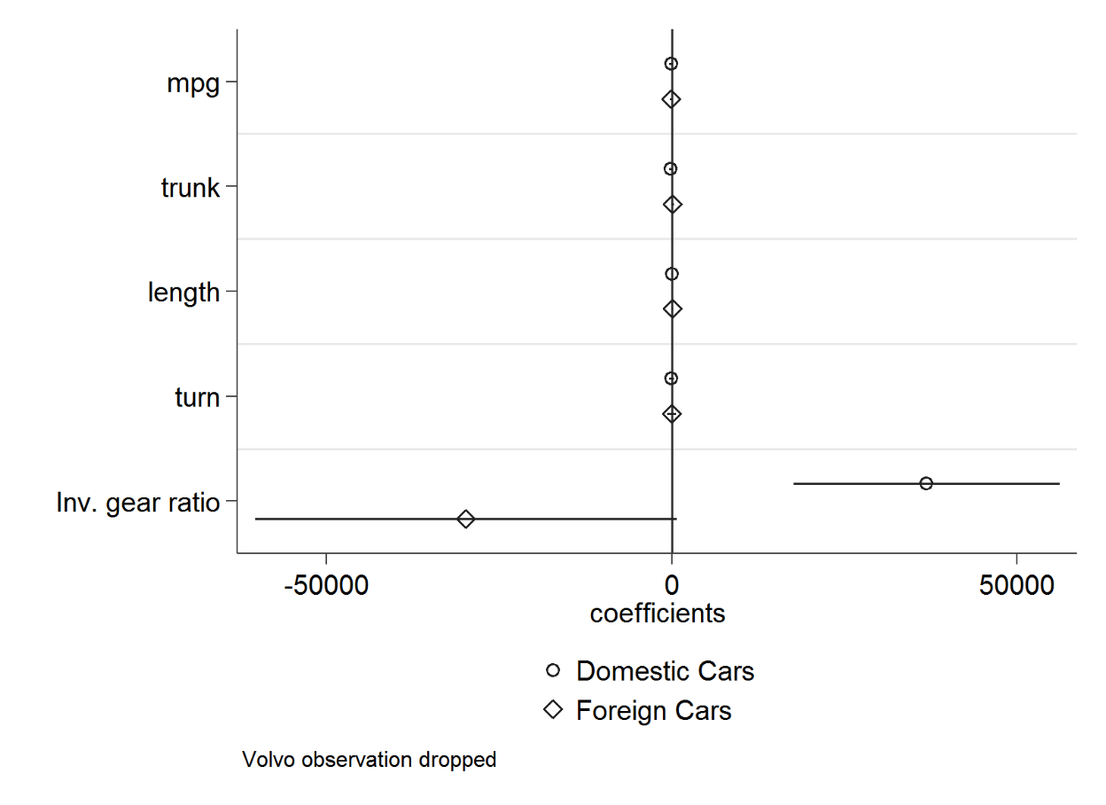
Output directory: tables.rtf and coef…png

Slide 46
Improvements
Compare the results where the DV is price in levels and logs: show all comparisons in the table and figure. (think of writing a program that cycles through all DV’s).
Same thing for the Volvo data point. Compare with and without.
Same thing with inverse gear ratio and the gear ratio.
Add some descriptive analysis, summary statistics and histogram plots of the variables
…

Slide 47
Some useful comments
Create a branch and check it out.
git branch ____
git checkout ____
make changes
git status
git add –A
git commit –m “statement”
git push –u origin ____
git checkout master
git pull
git merge ____
git push origin master
Delete branch
git push origin –delete ____

